Slide 1
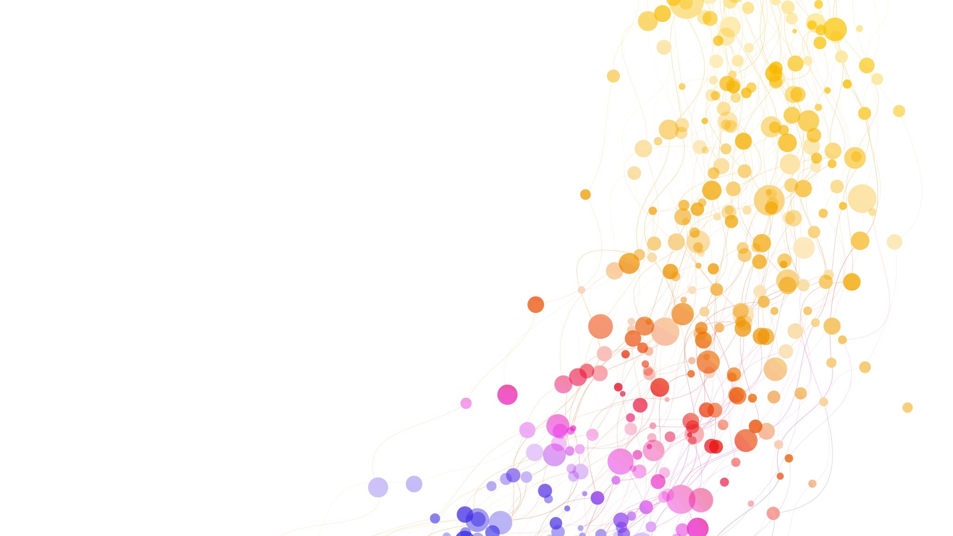

EPPS 6354 Expense tracker application
Guan Chen
Feb 22, 2024

Slide 2
Database Goal
Data Collection:
Bank statements from the 2023 year
Goal:
Identify and track spending habits

Slide 3
Database Schema
Transactions Relation
transaction_id
date
vendor
amount
Vendor Relation
vendor_id
vendor
category

Slide 4
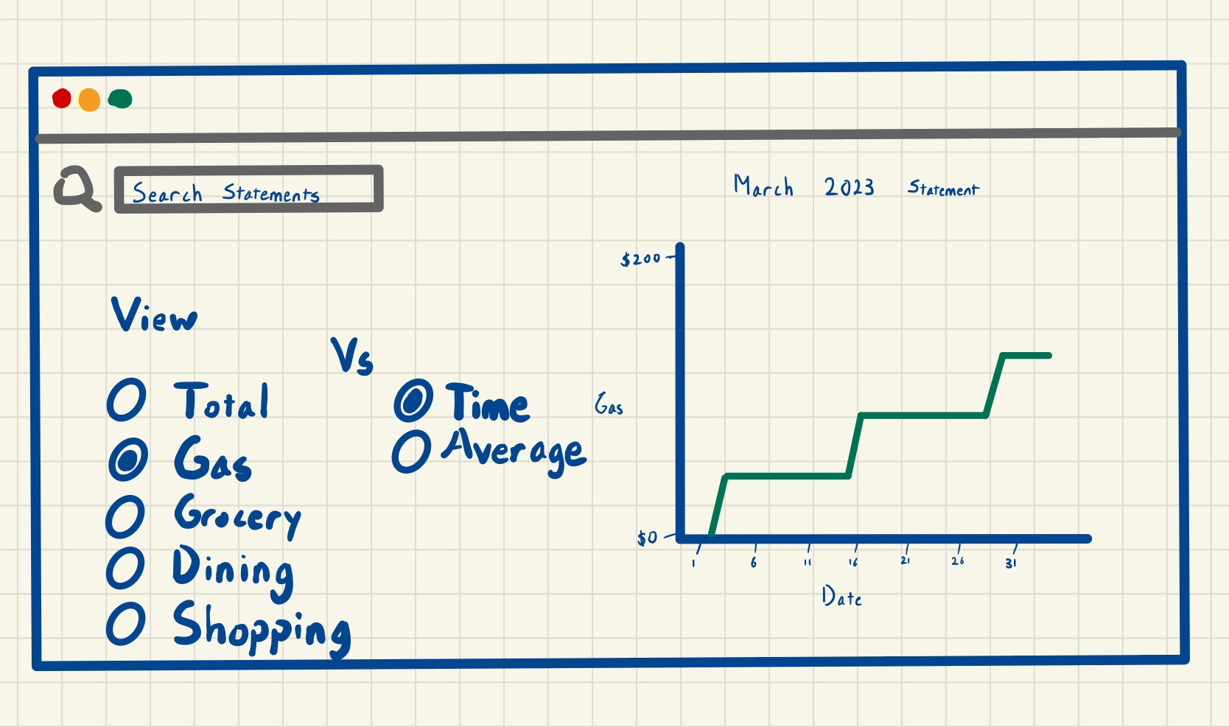
Database Interface

Slide 5
Tada
https://guanhchen.shinyapps.io/expenseapp/

